Slide 1
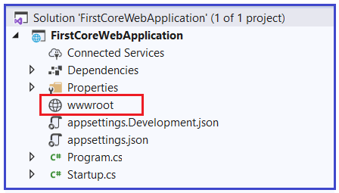
What is wwwroot folder in ASP.NET Core?
By default, the wwwroot folder in the ASP.NET Core application is treated as the webroot folder and this folder or directory should be present in the root project folder. In ASP.NET Core Application, the Static files can be stored in any folder under the webroot folder and can be accessed with a relative path to that root.
Adding the wwwroot (webroot) folder in ASP.NET Core Application:
When you create an ASP.NET Core Web Application with Web and MVC Template, then by default this folder (wwwroot) is created in the root project folder. But if you create a new .NET Core Application with Empty template then by default this folder is not going to be created by Visual Studio.
As we are discussing everything from scratch, let us create an ASP.NET Core Application using the Empty Project template and then understand how to add the wwwroot folder in it.

Slide 2

What the wwwroot (webroot) folder is going to contain in ASP.NET Core:
only those files that are present inside in the webroot – wwwroot folder or any subfolder under it can be served over an HTTP request.
All other files are blocked and cannot be served by default.
Generally, there should be separate folders for the different types of static files such as JavaScript, CSS, Images, Library scripts, etc inside the wwwroot folder as shown below:
Now, you can access static files such as CSS, js, lib with base URL and file name. For example, you can access the above site.js file in the js folder by https://localhost:<port>/js/site.js
Note: In order to serve the static files, you need to include the app.UseStaticFiles() middleware component in the ‘Configure()’ method of Startup.cs file.

